Slide 1

Group Conceptual Design Review
By:
Ian Adelman​
Devin Hoopes​
Natalie Gonzalez ​
Alex Reinert

Slide 2





Agenda
Meet the Team
Problem Statement
Design
Internal Design
Questions
Notes:
Ian Slide

Slide 3





Meet the Team
Ian Adelman
System Engineer
Devin Hoopes
System Engineer
Natalie Gonzalez
Team Lead
Alex Reinert
System Engineer
3
Notes:
Ian Slide

Slide 4

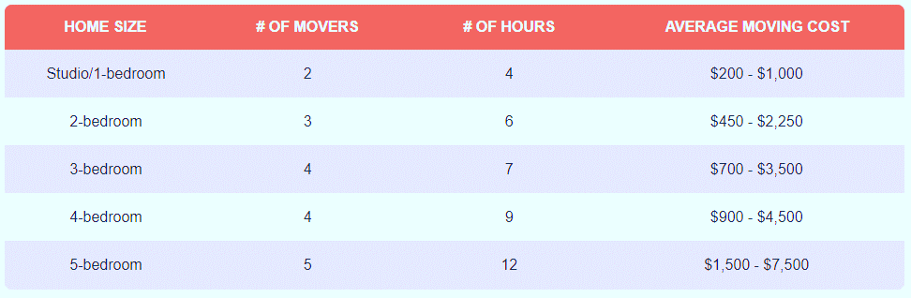
Review of the Problem Statement [1]
Transporting heavy furniture up or down one flight of straight stairs is difficult and potentially dangerous
Notes:
https://www.forbes.com/home-improvement/moving-services/movers-and-packers-cost/

Slide 5
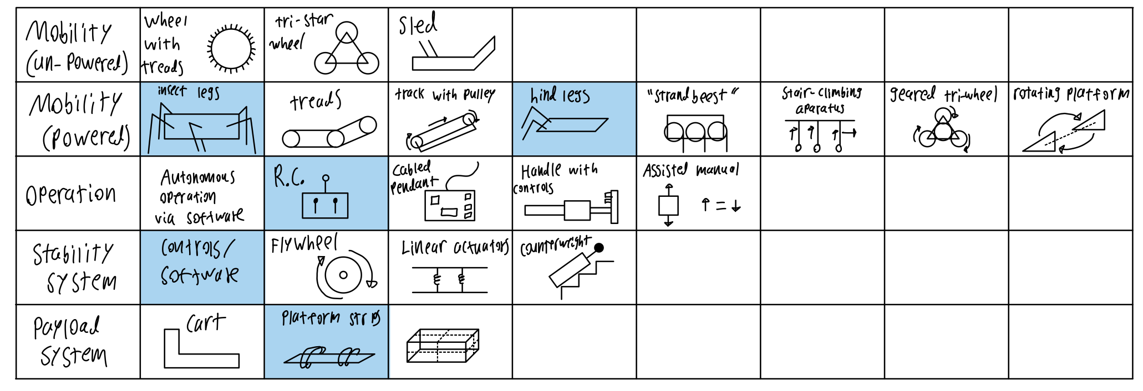

Morphological Chart

Slide 6
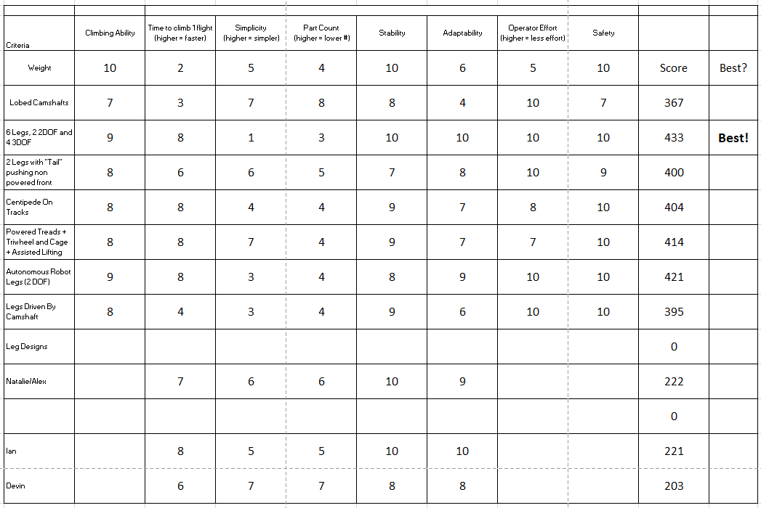
Decision Matrix

Slide 7
The Decision

Slide 8
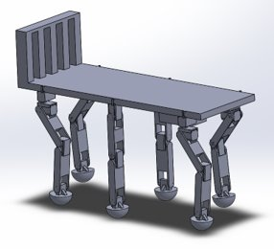
System Assembly
Brackets
Platform
3 DOF Legs
2 DOF Legs
Electronics Bay
Notes:
Add subsystems here

Slide 9
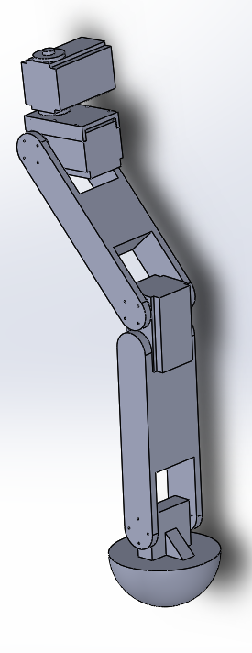
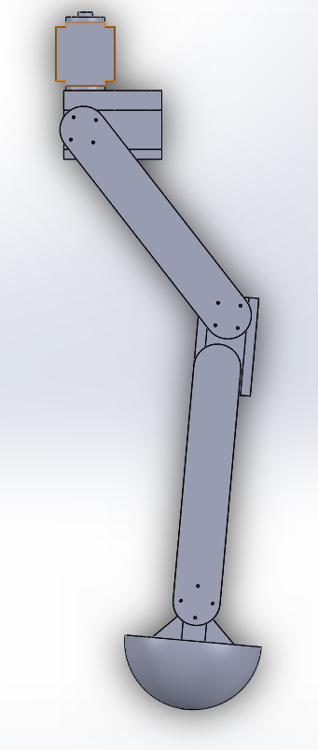
Legs
The system shall transport furniture repeatedly up and down one floor within a residential building. [2.1.1]
The system shall not destructively alter the environment. [2.3.2]
The system shall not damage the furniture. [2.3.3]
Isometric
Right view
Servos
Leg Segments
Feet

Slide 10
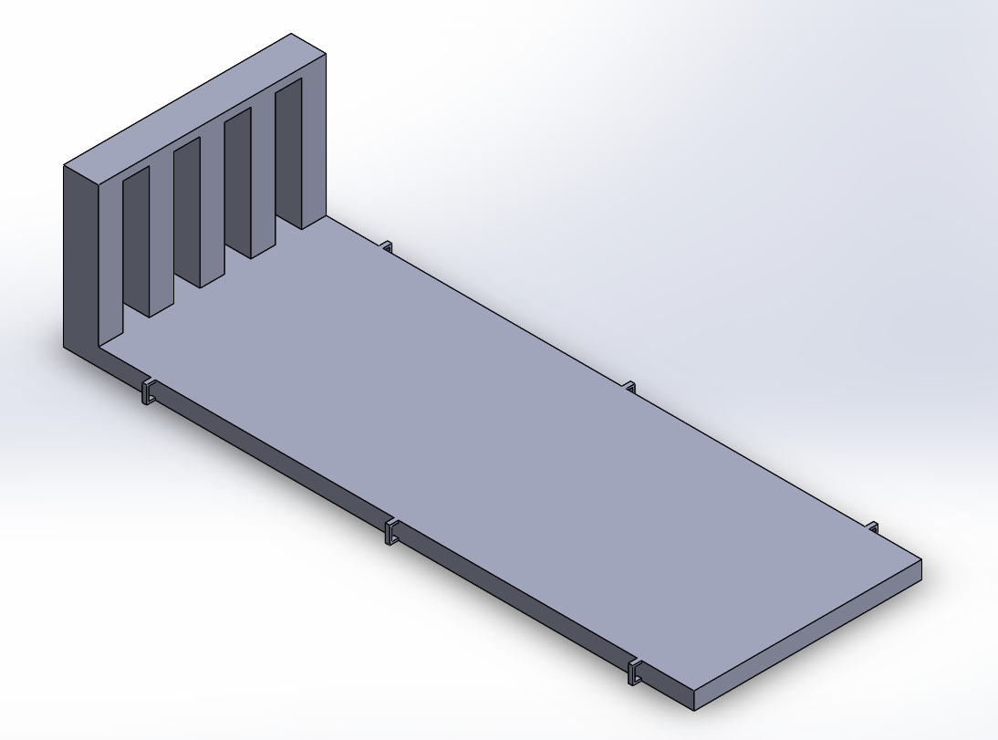
Platform
The system shall accommodate up to a 4-seater sofa. [2.1.2]
The system shall accommodate up to a 5-shelf bookshelf. [2.1.3]
Brackets
Isometric view

Slide 11

Sizing
The system shall be transportable in the back of an average American pickup truck in addition to the transported furniture. [2.2.2]
The system shall fit within a standard stairway according to Section R311.7.1 of the 2021 International Residential Code (IRC). [2.2.1]
36”
13”
Top view

Slide 12
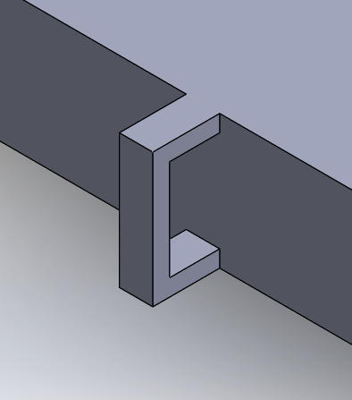
Brackets
The system shall not destructively alter the environment. [2.3.2]
The system shall not damage the furniture. [2.3.3]
Enlarged View

Slide 13
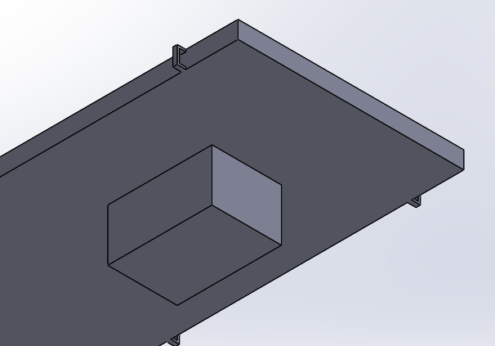
Electronics Bay
Battery
(inside)
Microcontroller
(inside)
RC Hardware
(inside)
Bottom of platform

Slide 14
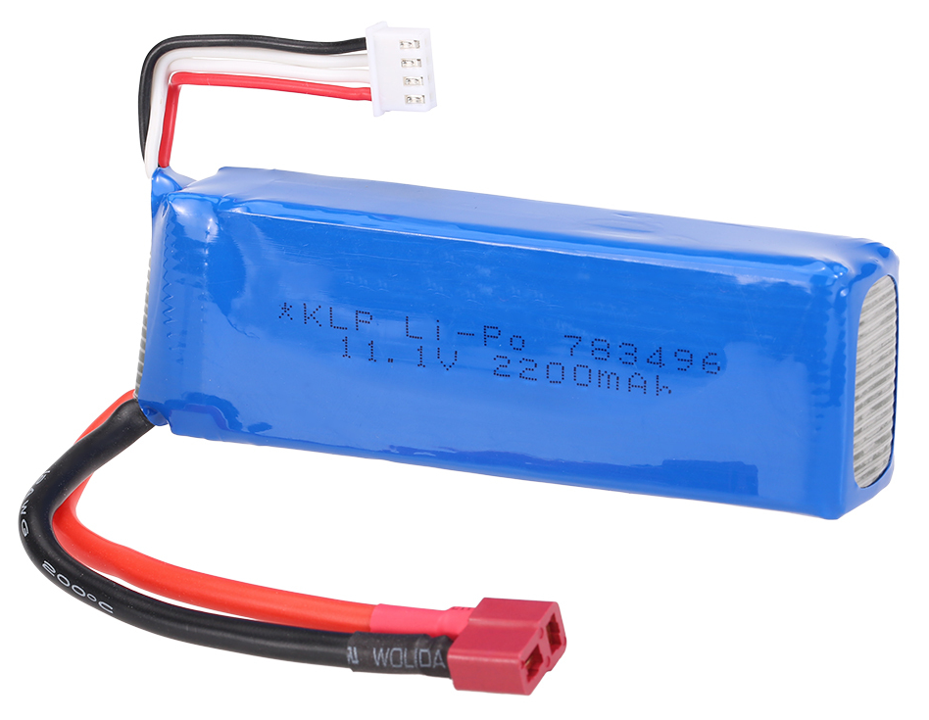

Battery
The system shall not destructively alter the environment. [2.3.2]
The system shall be reusable. [2.1.4]
Rechargeable Battery

Slide 15

Remote Control
The system shall cause less injury and strain than an average moving job. [2.3.1]
Control for System

Slide 16
Hardware Block Diagram
RC Controller
Microcontroller
Battery
Emergency Stop
Servos

Slide 17
Process Flowchart
Start at bottom of stairs
Load and secure furniture
Sense next step
Is there another stair?
Climb one stair
Yes
STOP
No

Slide 18
References
[1] A. Ogletree, “How Much Do Movers Cost In 2023?,” Forbes Home. Accessed: Sep. 24, 2023. [Online]. Available: https://www.forbes.com/home-improvement/moving-services/movers-ad-packers-cost/

Slide 19


Questions?

